Slide 1
Meeting 8/2/2022
Joren Janzing

Slide 2
Content
Why does model respond to other wind anomalies?
Wind conditions associated with high melt events

Slide 3
What is different in the 40s?

Slide 4
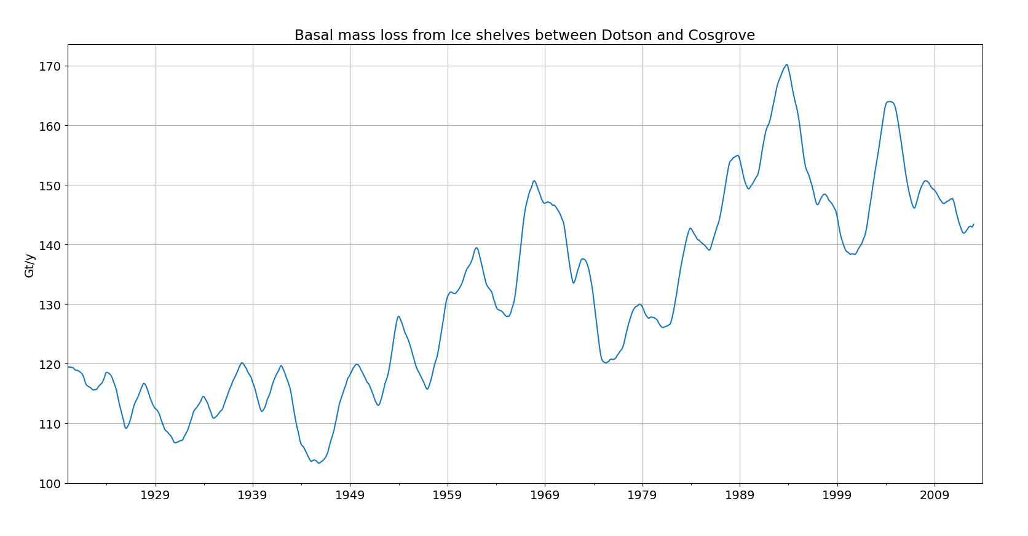

Slide 5
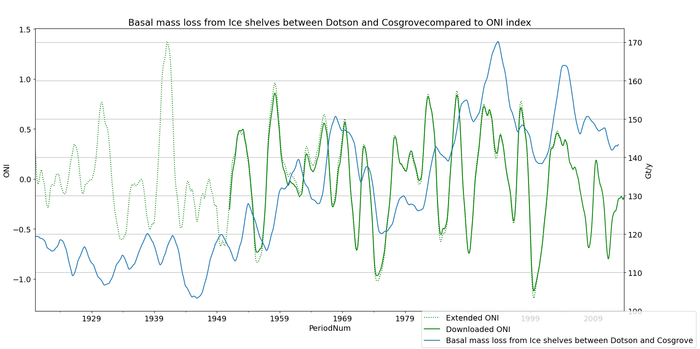

Slide 6
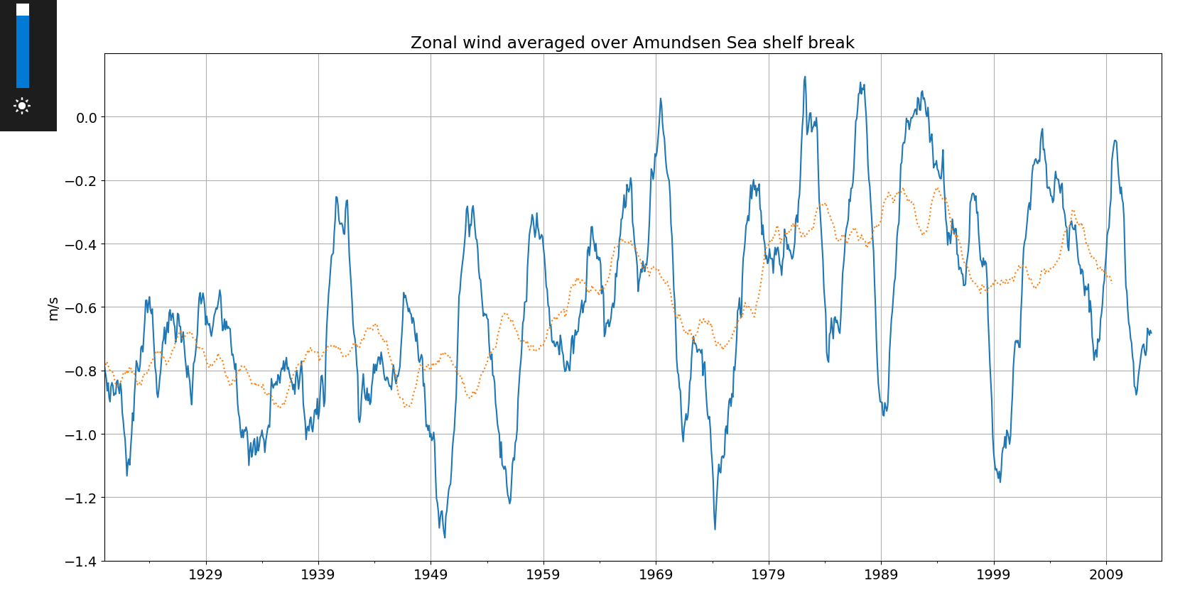

Slide 7
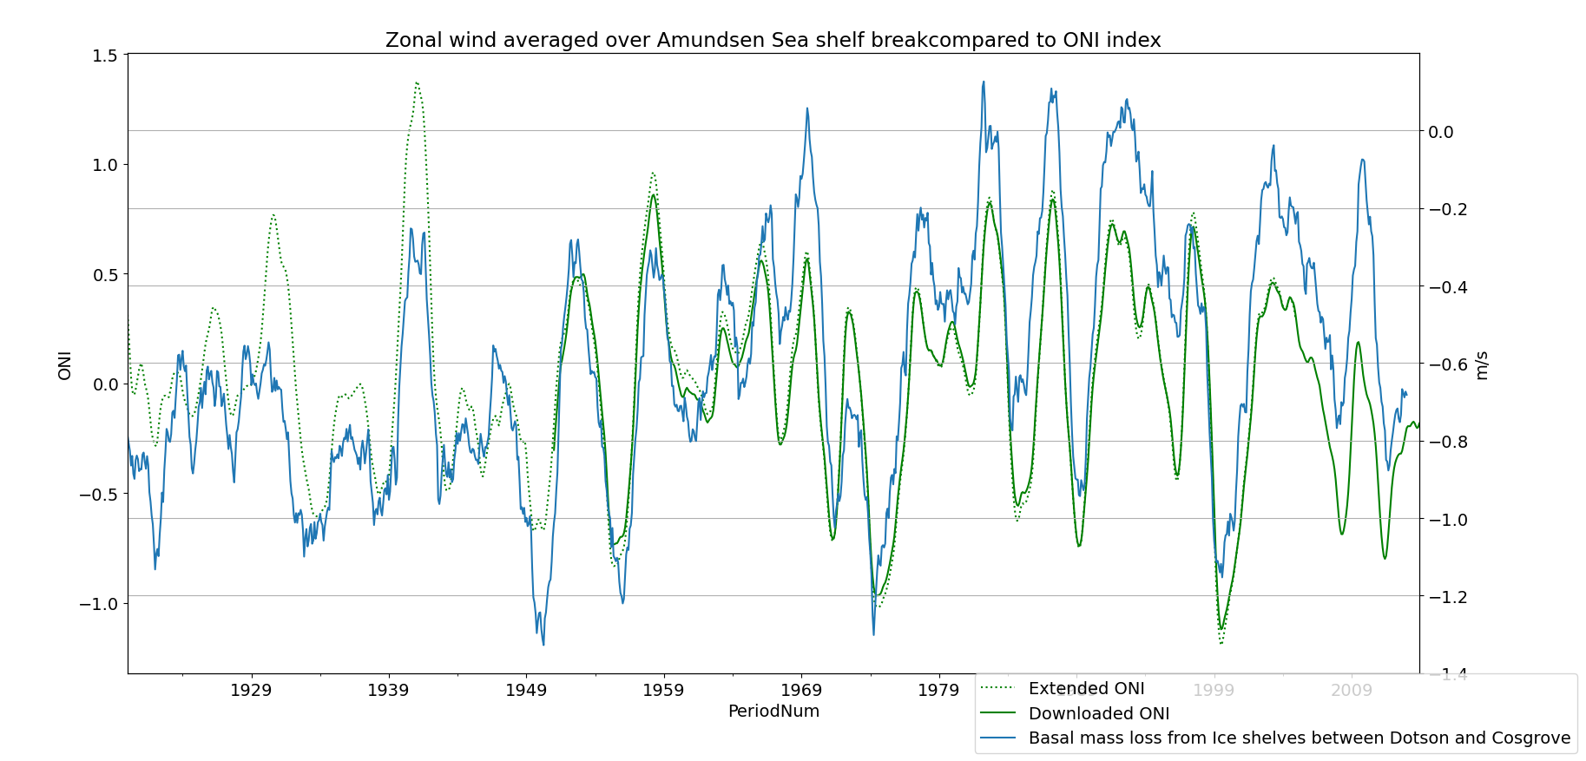

Slide 8
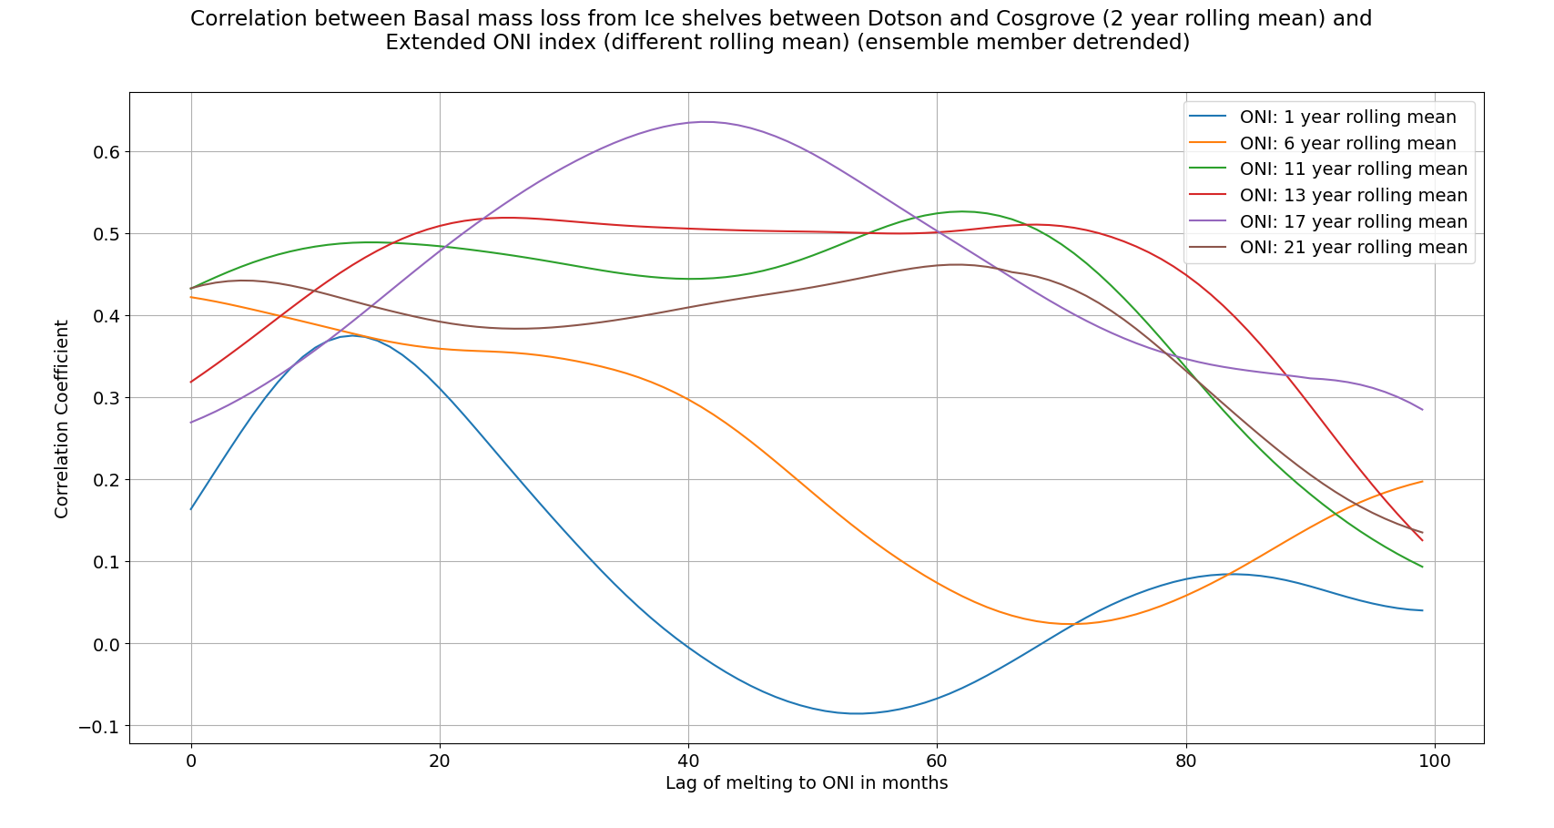

Slide 9
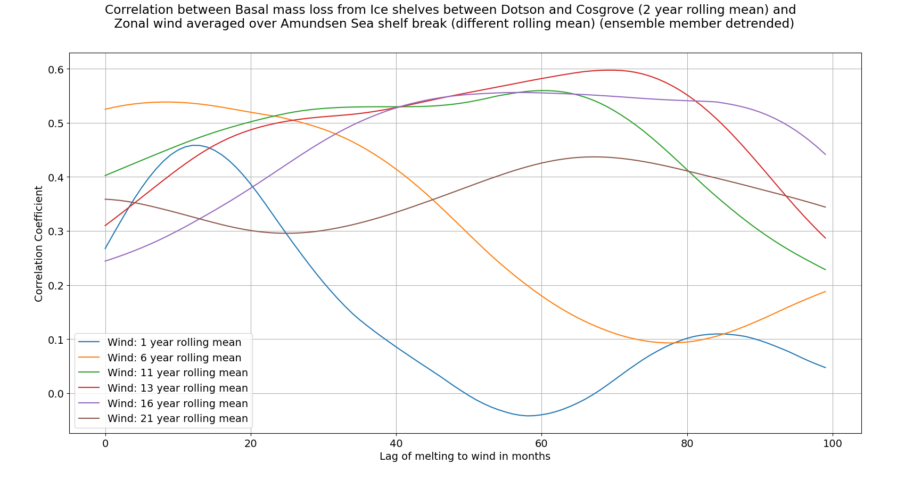

Slide 10
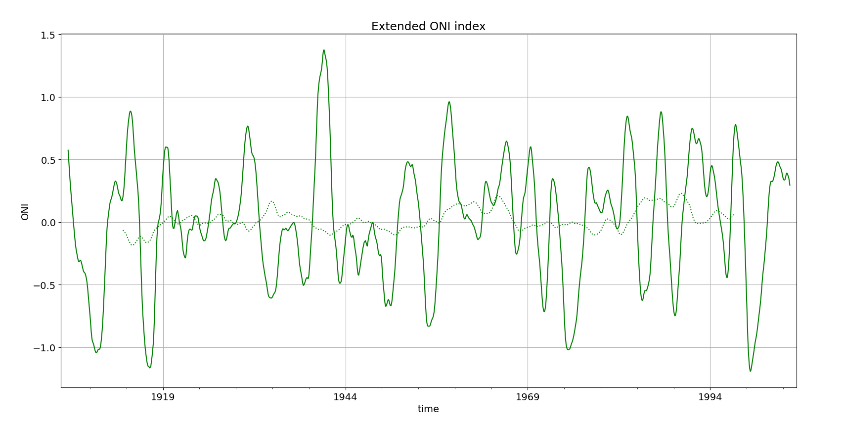

Slide 11
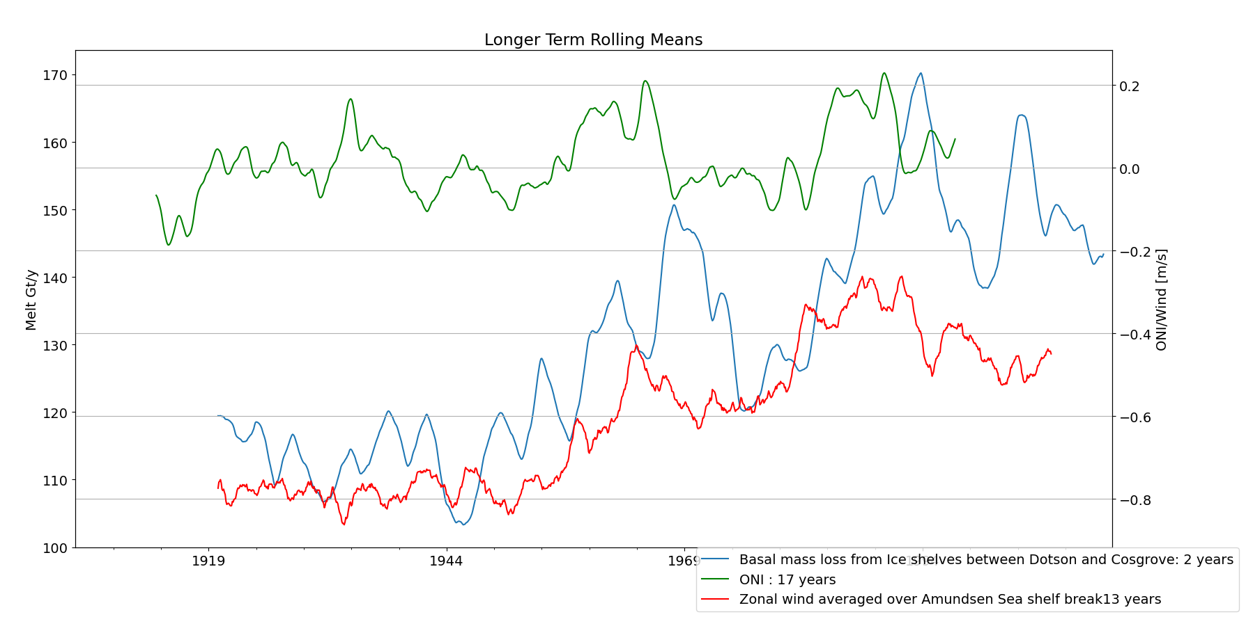

Slide 12
Conclusion part 1
Ensemble mean melt seems to be related to longer term (decade) shelf wind and ONI forcing.
High peaks in melt therefore depend on period before.
1940s ENSO is strong, but the ENSO events surrounding it are weak, ergo: weaker melt…

Slide 13
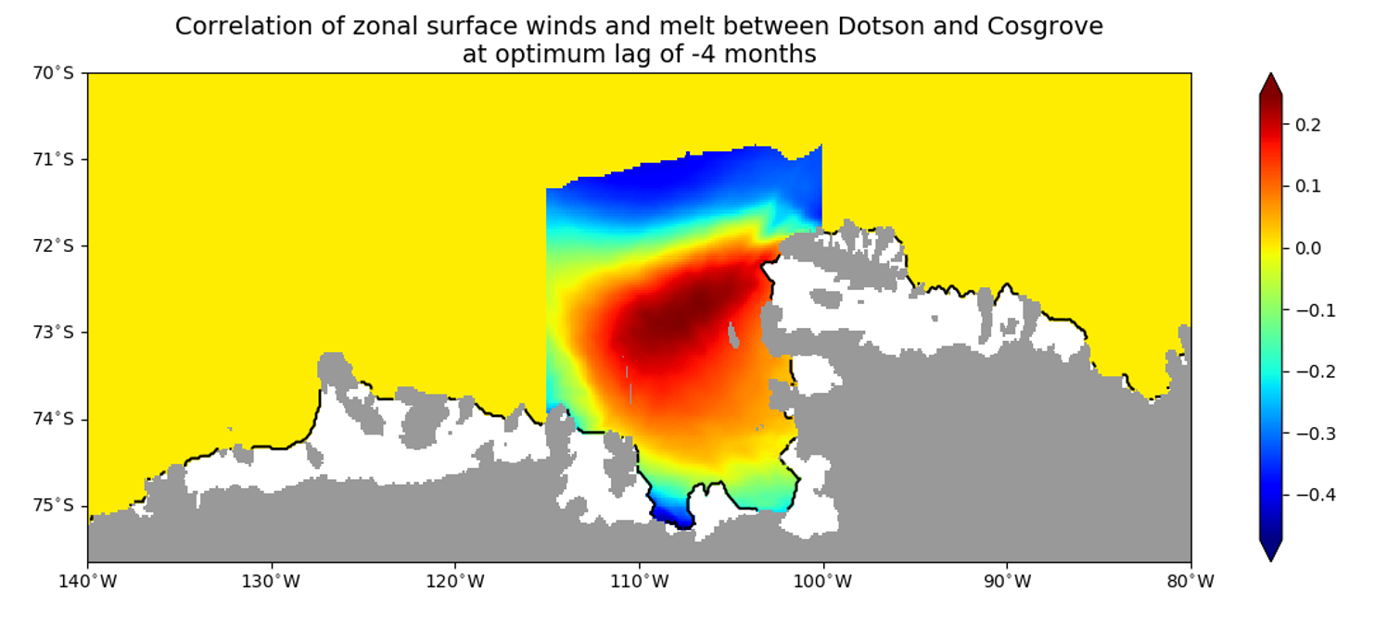
Show a Map!

Slide 14
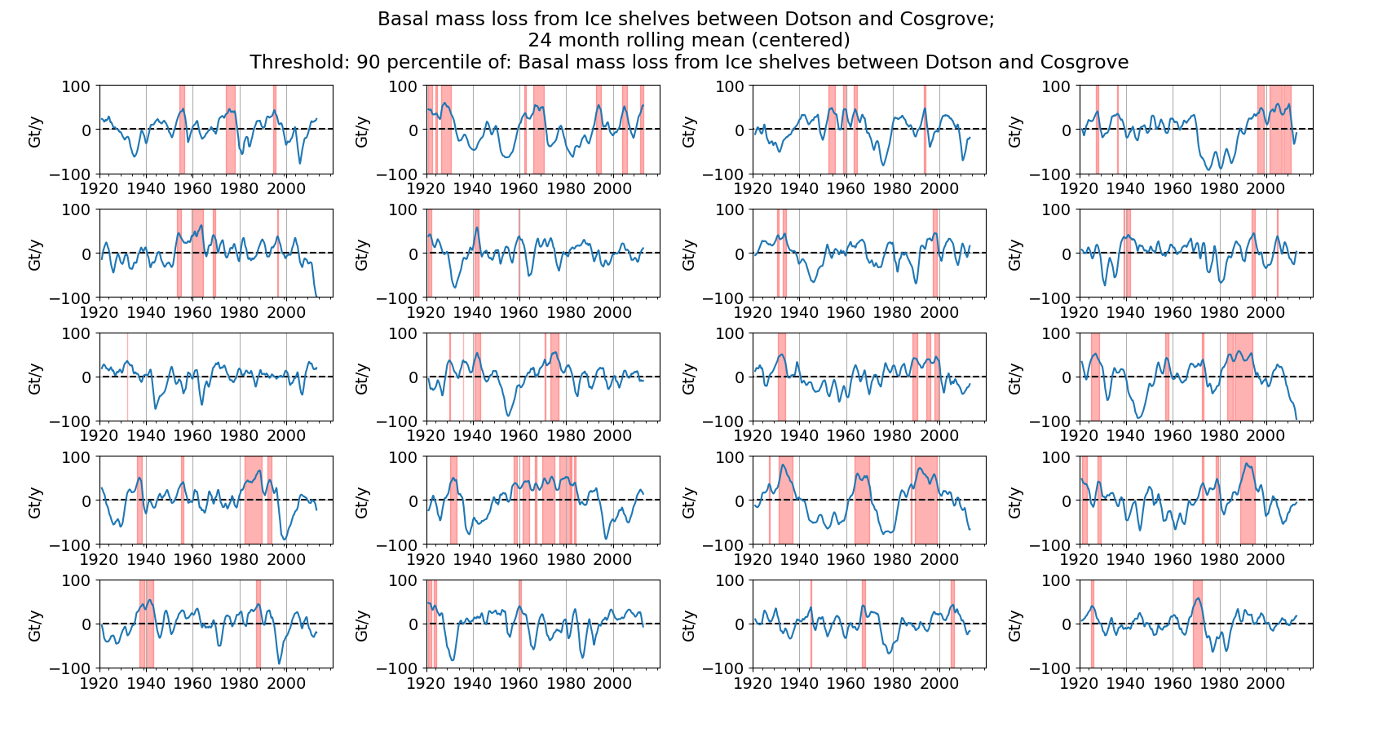

Slide 15
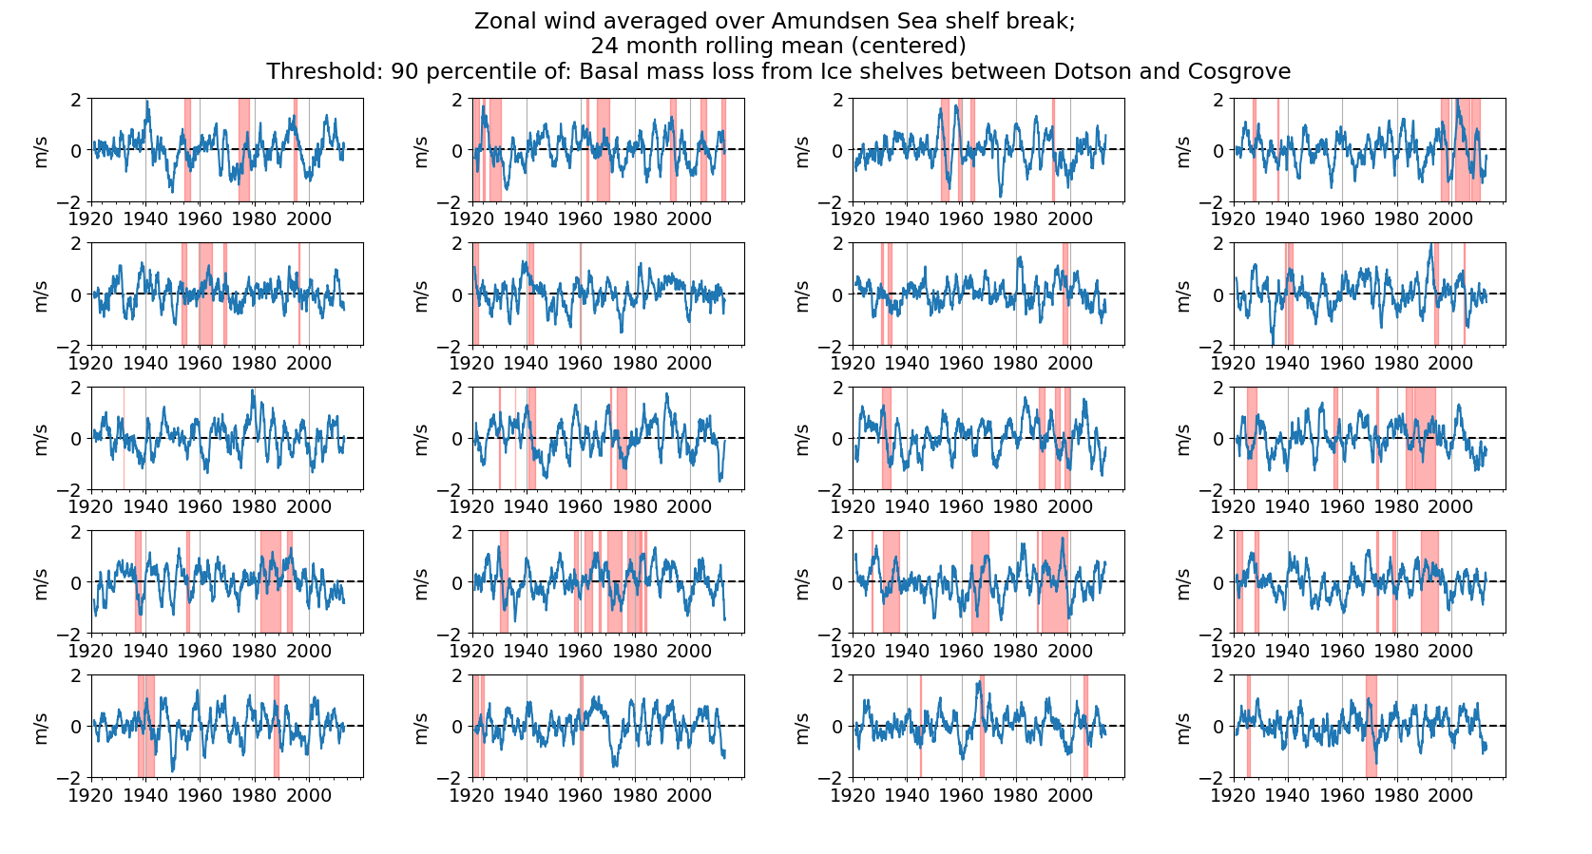

Slide 16
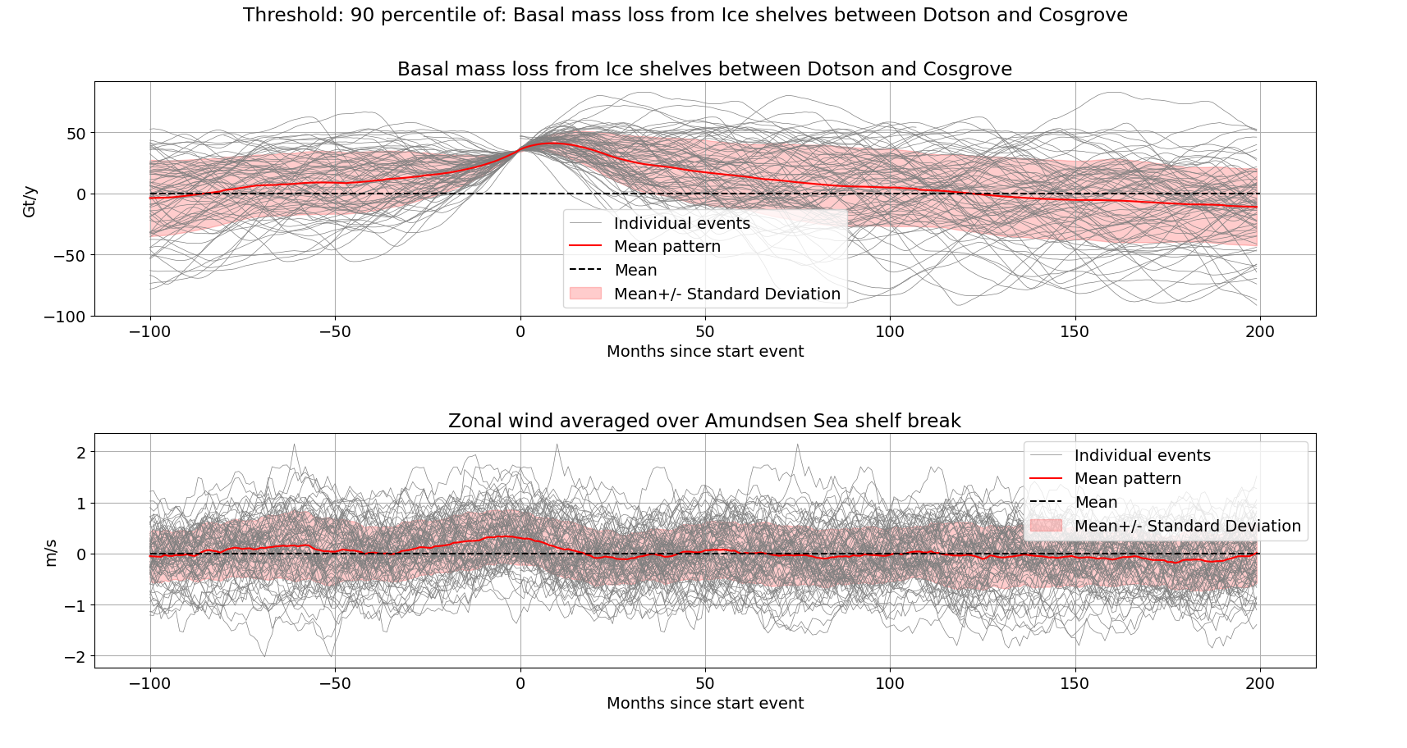

Slide 17
Extra
Travel
Security check

Slide 18
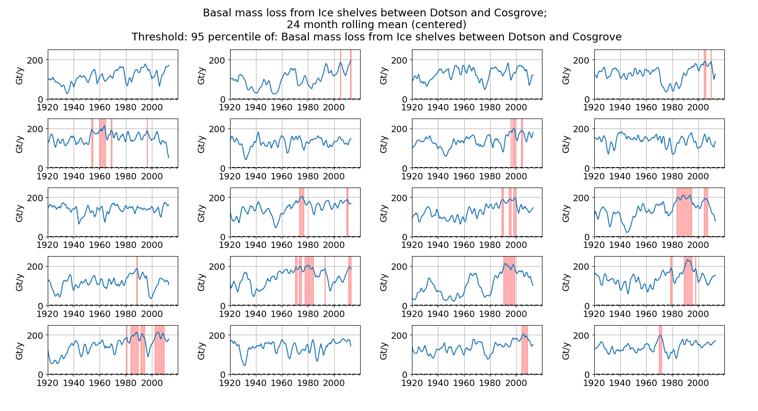

Slide 19
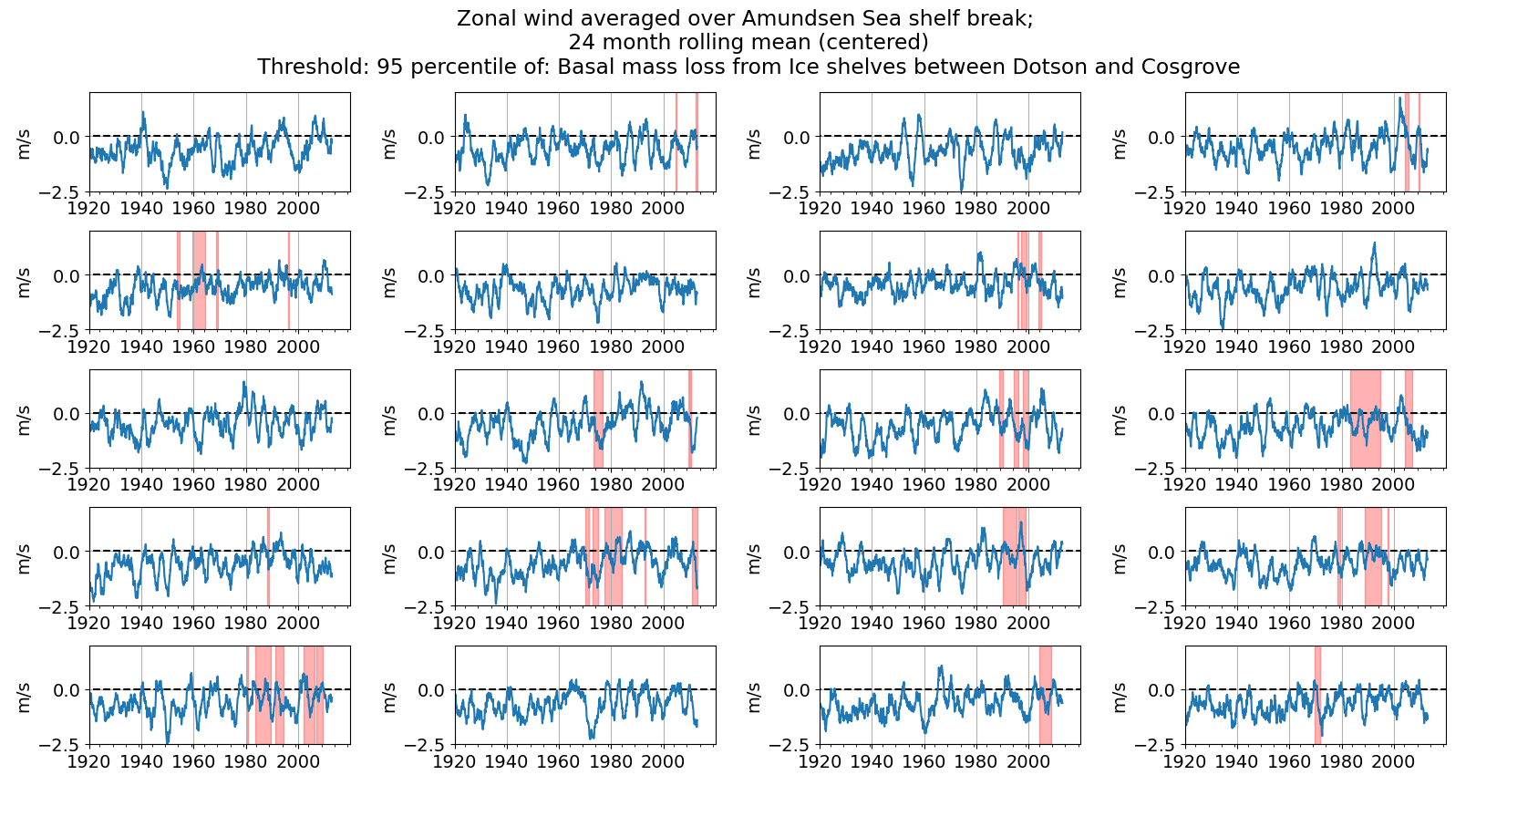

Slide 20
Same but detrended

